Slide 1

ZERO HUNGER

Slide 2
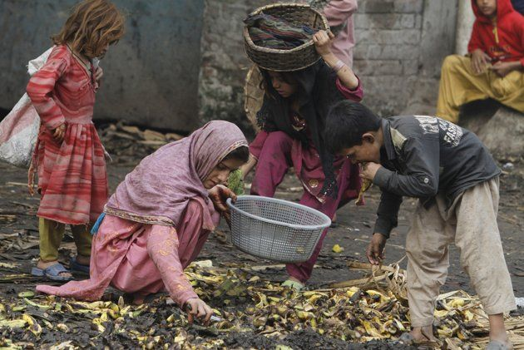
Reselling Food Waste In India Might Just Become The Next Big Thing
One-ninth of the world still suffers from starvation. You don’t have to do much mental math to realize that it is indeed a lot. Despite the staggering numbers of people who suffer from hunger, the world wastes a lot of food. About one-third of the food that is produced is wasted. That half a sandwich that you just tossed into the bin counts too. And all this food that is waste find it’s way into landfills that contribute to up to 8% of total greenhouse gas emissions.

Slide 3
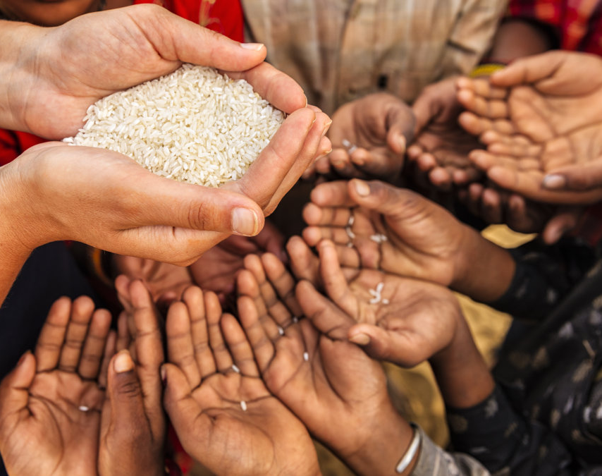
Reduce World Hunger
We all want our families to have enough food to eat that is safe and nutritious. A world with zero hunger can positively impact our economies, health, education, equality and social development. It's a key piece of building a better future for everyone. Sharing nutritious food with poor people helps decrease in world’s hunger.

Slide 4
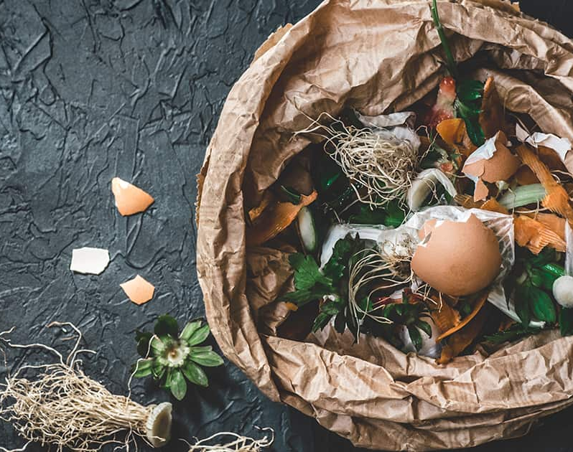
FOOD WASTES CAUSED BY HOUSEHOLD WASTES
Household wastes also known as domestic waste or residential waste, is disposable materials generated by households. This waste can be comprised of non-hazardous and hazardous waste. Non-hazardous waste can include food scraps, paper, bottles, etc. which can be recycled or composted.
Most of the food wastes are from restaurants and household. These wastes are done by long storage of food which are not preserved well. This can be decreased by donating food which is not expired and which is not useful for us. This decreased the waste of food as well as the hunger of many will be shortened .

Slide 5
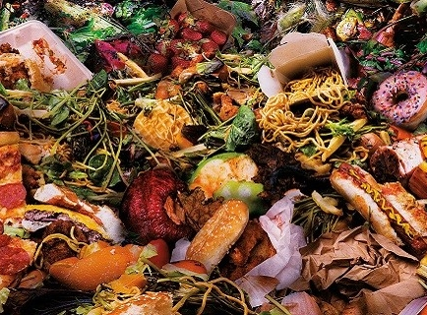
TONS OF FOOD WASTAGE FROM RESTAURANTS
According to a recent report, a half a pound of food is wasted per meal in restaurants, whether it's from what is left on a customer's plate, or in the kitchen itself. Approximately 85% of the food that isn't used in a typical American restaurant is thrown out while only a small percentage is recycled or donated.
There are two main factors to take into account as you track your food waste. You need to consider how much food is being wasted and how many people are coming through your restaurant. By gathering data for both of these variables, you can get a better sense of what your biggest source of waste is.

Slide 6
Tips for Food Waste Management in Restaurants 1. Avoid over-buying stock. 2. Store food correctly. 3. Practice stock rotation regularly. 4. Temperature control. 5. Label food correctly. 6. Keep a stock inventory. 7. Inspect all deliveries against the order specification. 8. Keep a close eye on portion control. 9. Donate leftovers to a local charity. 10. Anticipate the demand with care.

Slide 7
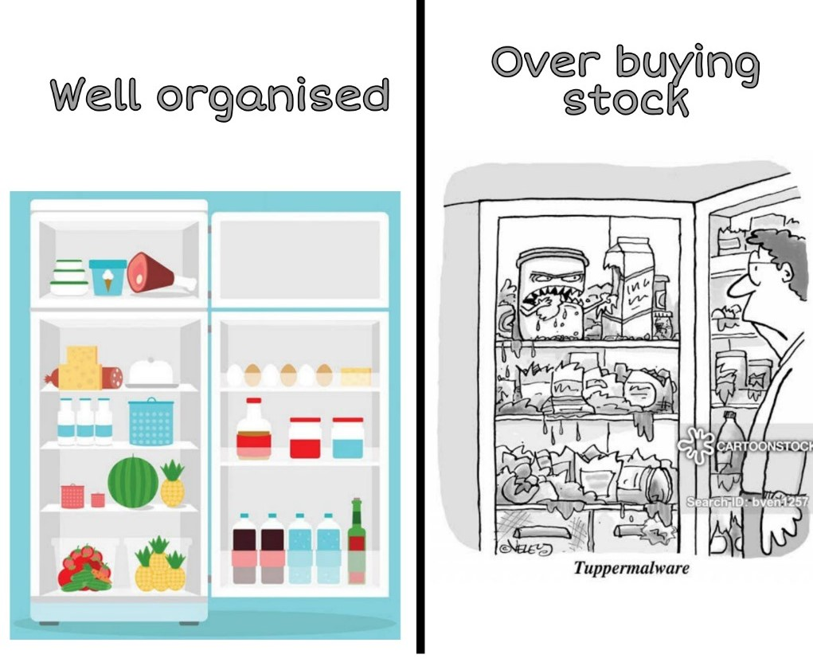
Store food correctly to reduce “FOOD WASTAGE”
Make sure that your fridges and freezers are running at the right temperatures, ensure that low risk foods are always stored on higher shelves than high risk foods and keep food storage areas clean and tidy. Storing foods under the correct conditions is vital for preserving their quality and preventing pathogenic bacterial growth – both of which can quickly lead to food waste.
Food poisoning is frequently caused by bacteria from foods that have been incorrectly stored, prepared, handled or cooked. Food contaminated with food-poisoning bacteria may look, smell and taste normal. If food is not stored properly, the bacteria in it can multiply to dangerous levels.

Slide 8
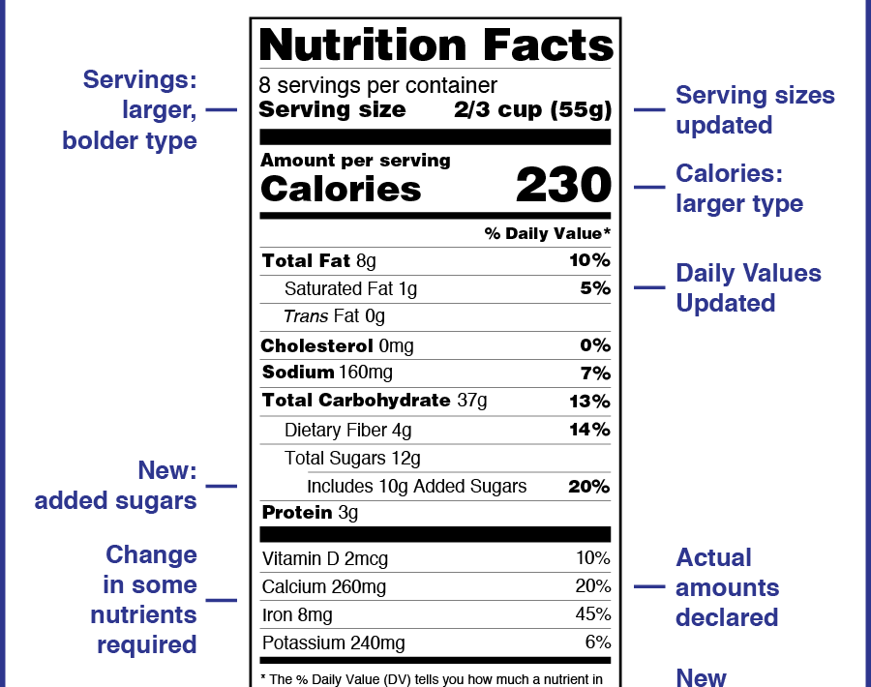
Labelling food correctly so that no food is wasted
If foods are decanted into different containers for storage then make sure they are clearly labelled with allergens, date information and a product description. Keeping stock organized makes it much easier to keep track of what you have and what needs using, preventing un-labelled containers from being thrown away in error or because you don’t know what’s in them. Proper expiry date should be mentioned so that food will not be expired and there will be no loss of food.
If we know that food is going to expire then it should not be wasted by dumping, it should be donated to the poor. It will help in reducing the food wastage as well as hunger will be reduced. If its done all over the world almost 65% of hunger will be reduced

Slide 9
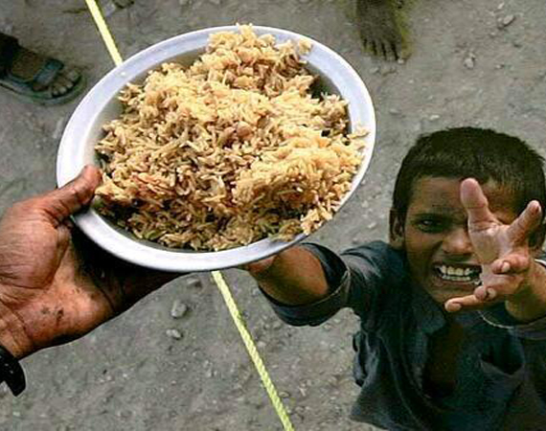
Donate leftovers to a local charity
Set up a link with a local charity, such as the fame share scheme, and donate any leftover meals and ingredients to people who desperately need them. You could also set up a link with a local food bank. This ensures that your leftover food goes to a good home, rather than to waste.
Food banks are community-based, professional organizations that collect food from a variety of sources and save the food in warehouses. The food bank then distributes the food to hungry families and individuals through a variety of emergency food assistance agencies, such as soup kitchens, youth or senior centers, shelters and pantries. Most food banks tend to collect less perishable foods such as canned goods because they can be stored for a longer time.

Slide 10
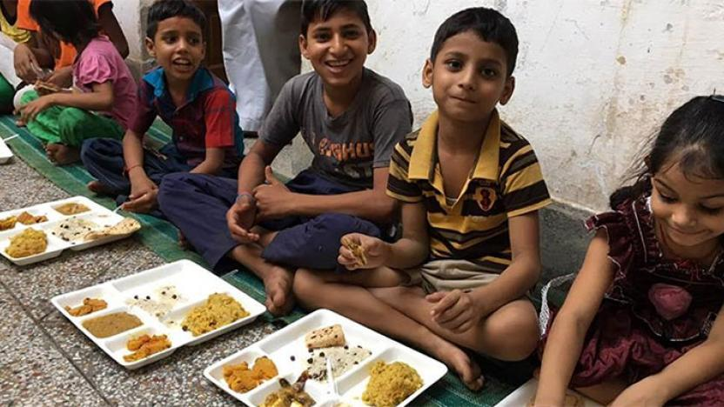
Food rescue programs take excess perishable and prepared food and distribute it to agencies and charities that serve hungry people such as soup kitchens, youth or senior centers, shelters and pantries. Many of these agencies visit the food bank each week to select fresh produce and packaged products for their meal programs or food pantries. Many also take direct donatio -ns from stores, restaurants, cafeterias, and individuals with surplus food to share. Remember to contact your local food pantry, food bank or food rescue operation to find out what items they accept. Also, food banks will often pick up donations free of charge.

